Slide 1
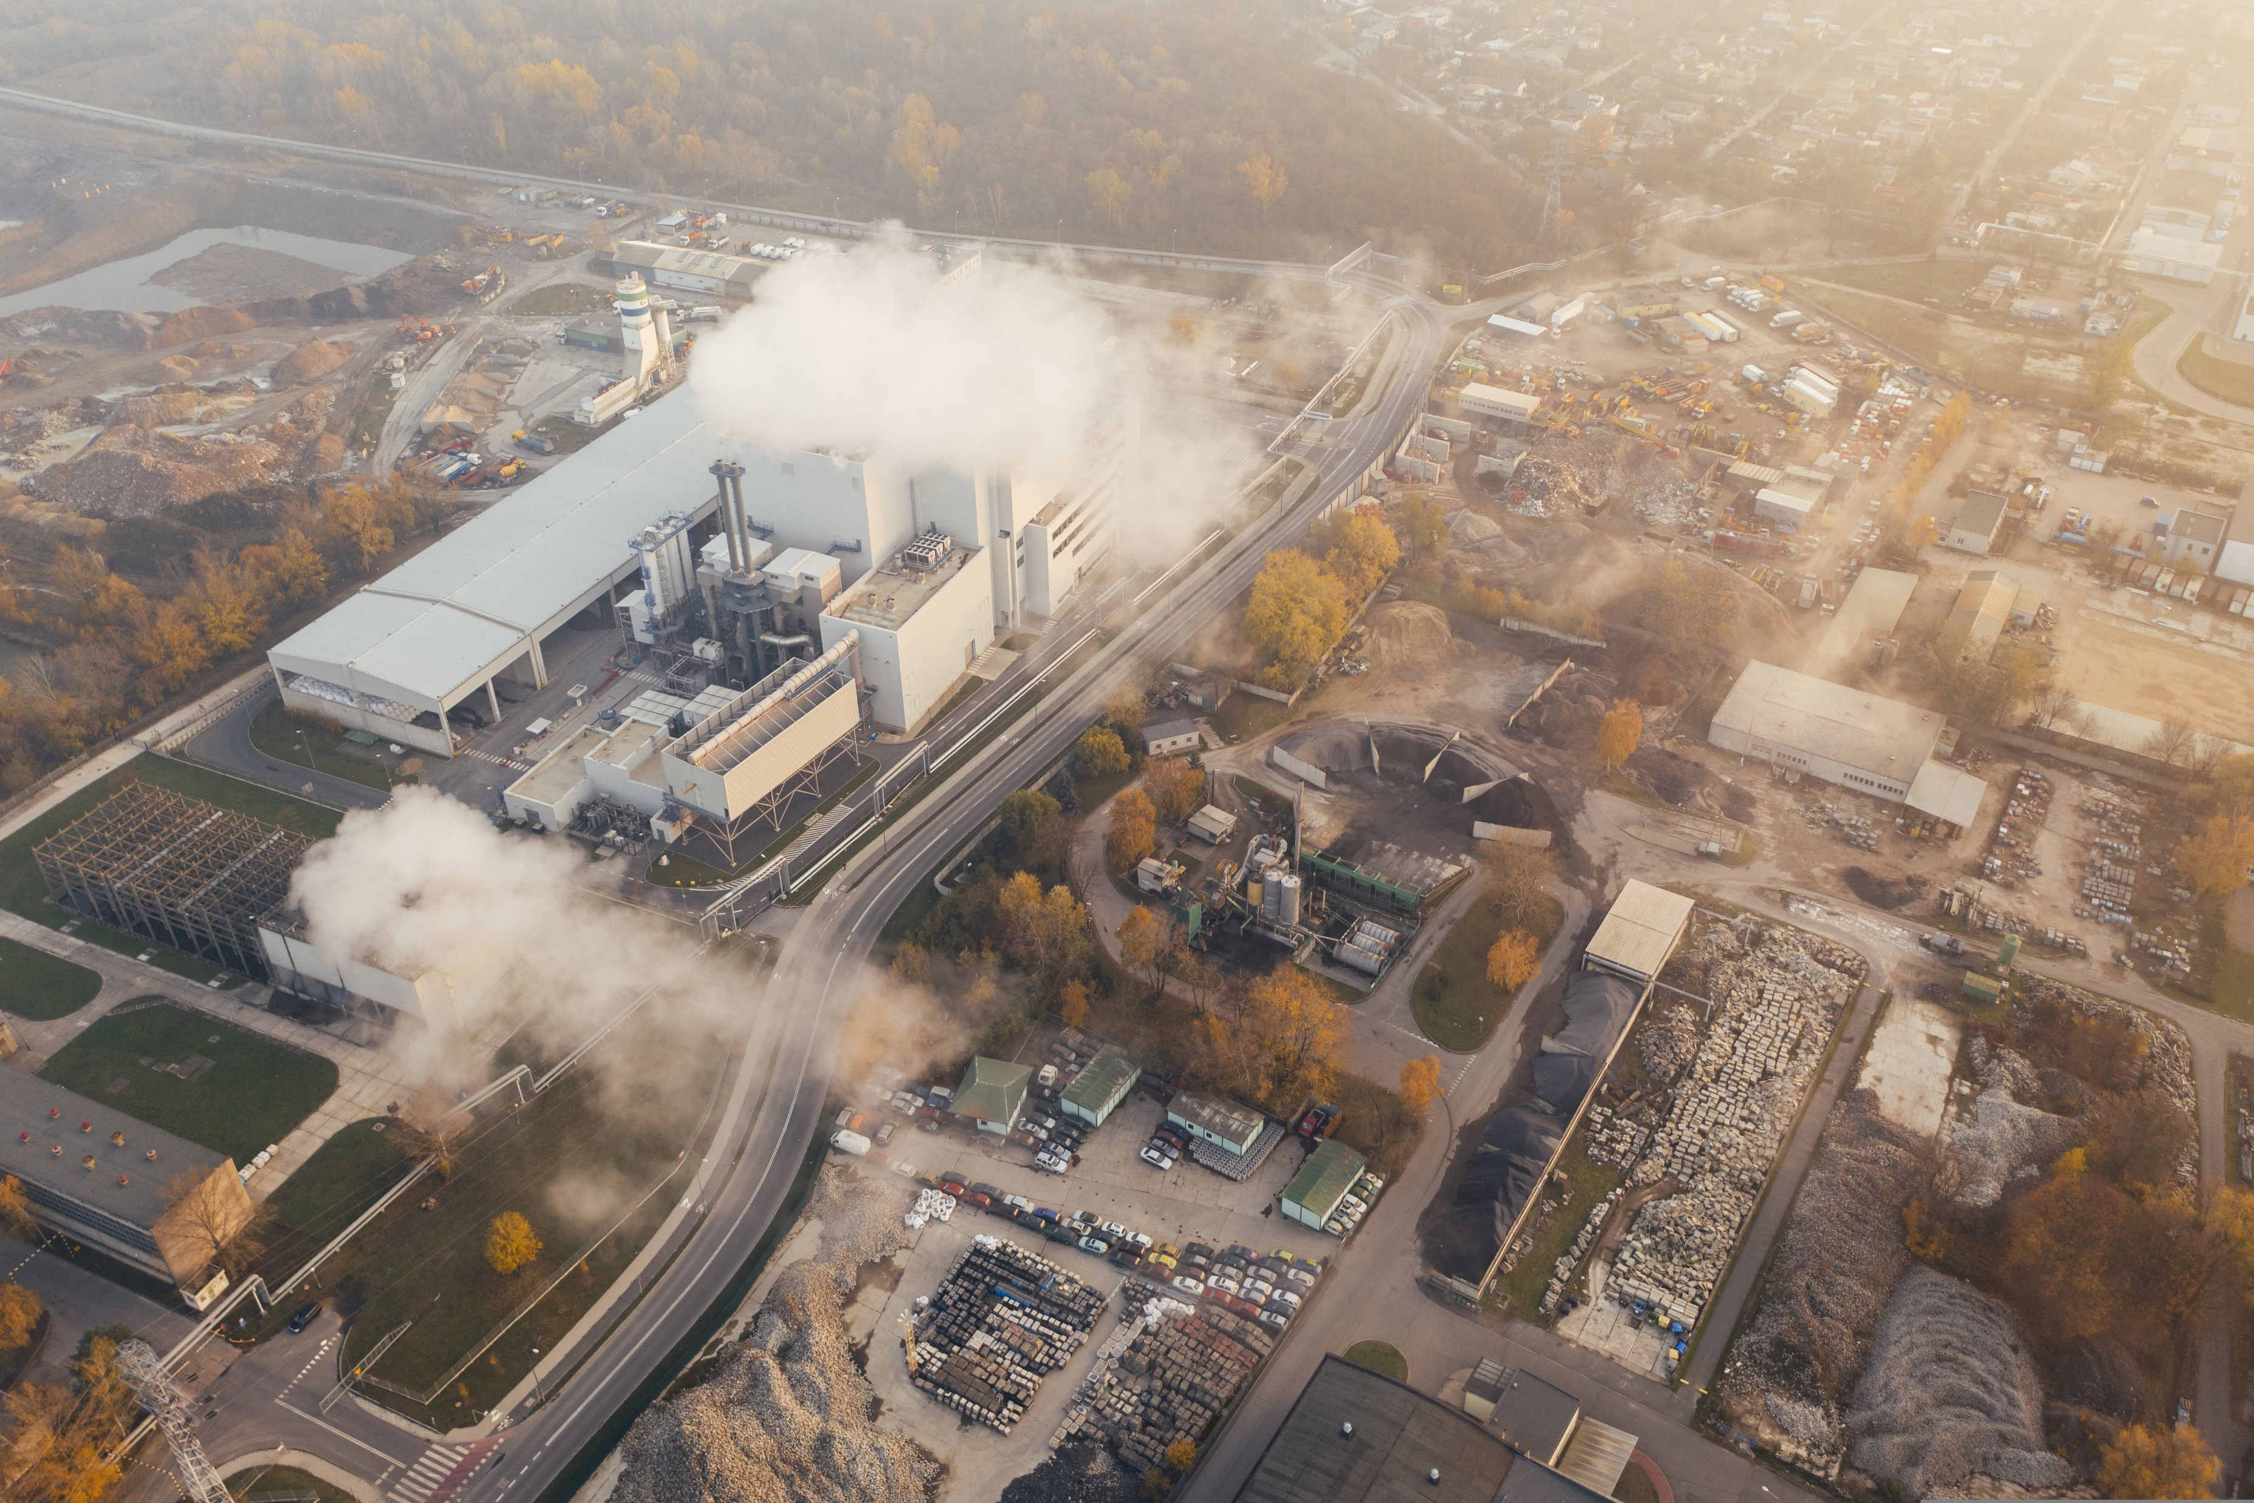
Pollution Aware:
A City’s Fight Against Pollution
Team-05
Members:
Prakhar Shrestha
Karthik Kamaldinni
Hemantha Kaval
Danish
Shreyash

Slide 2
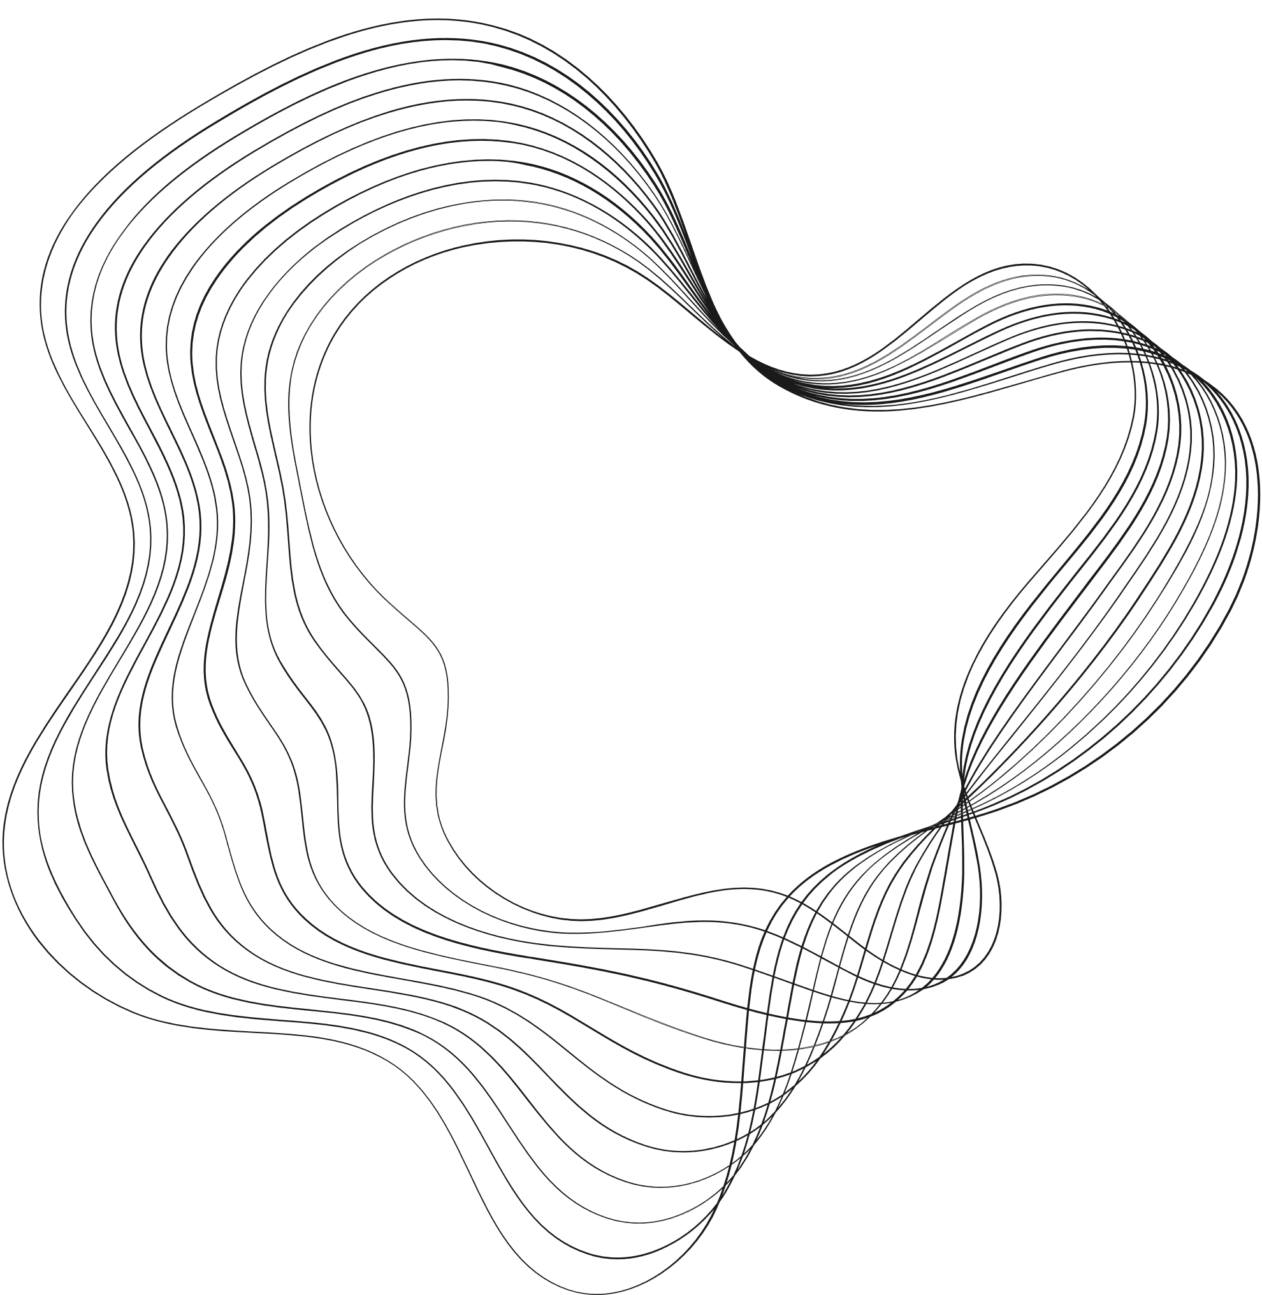


Larana, Inc.
POLLUTION MONITORING AND ALERT SYSTEM
[CPMAS]

Slide 3

CONTENT
01
Problem Definition
02
Problem Identified
03
Modules
04
Data Structures
05
Algorithms

Slide 4
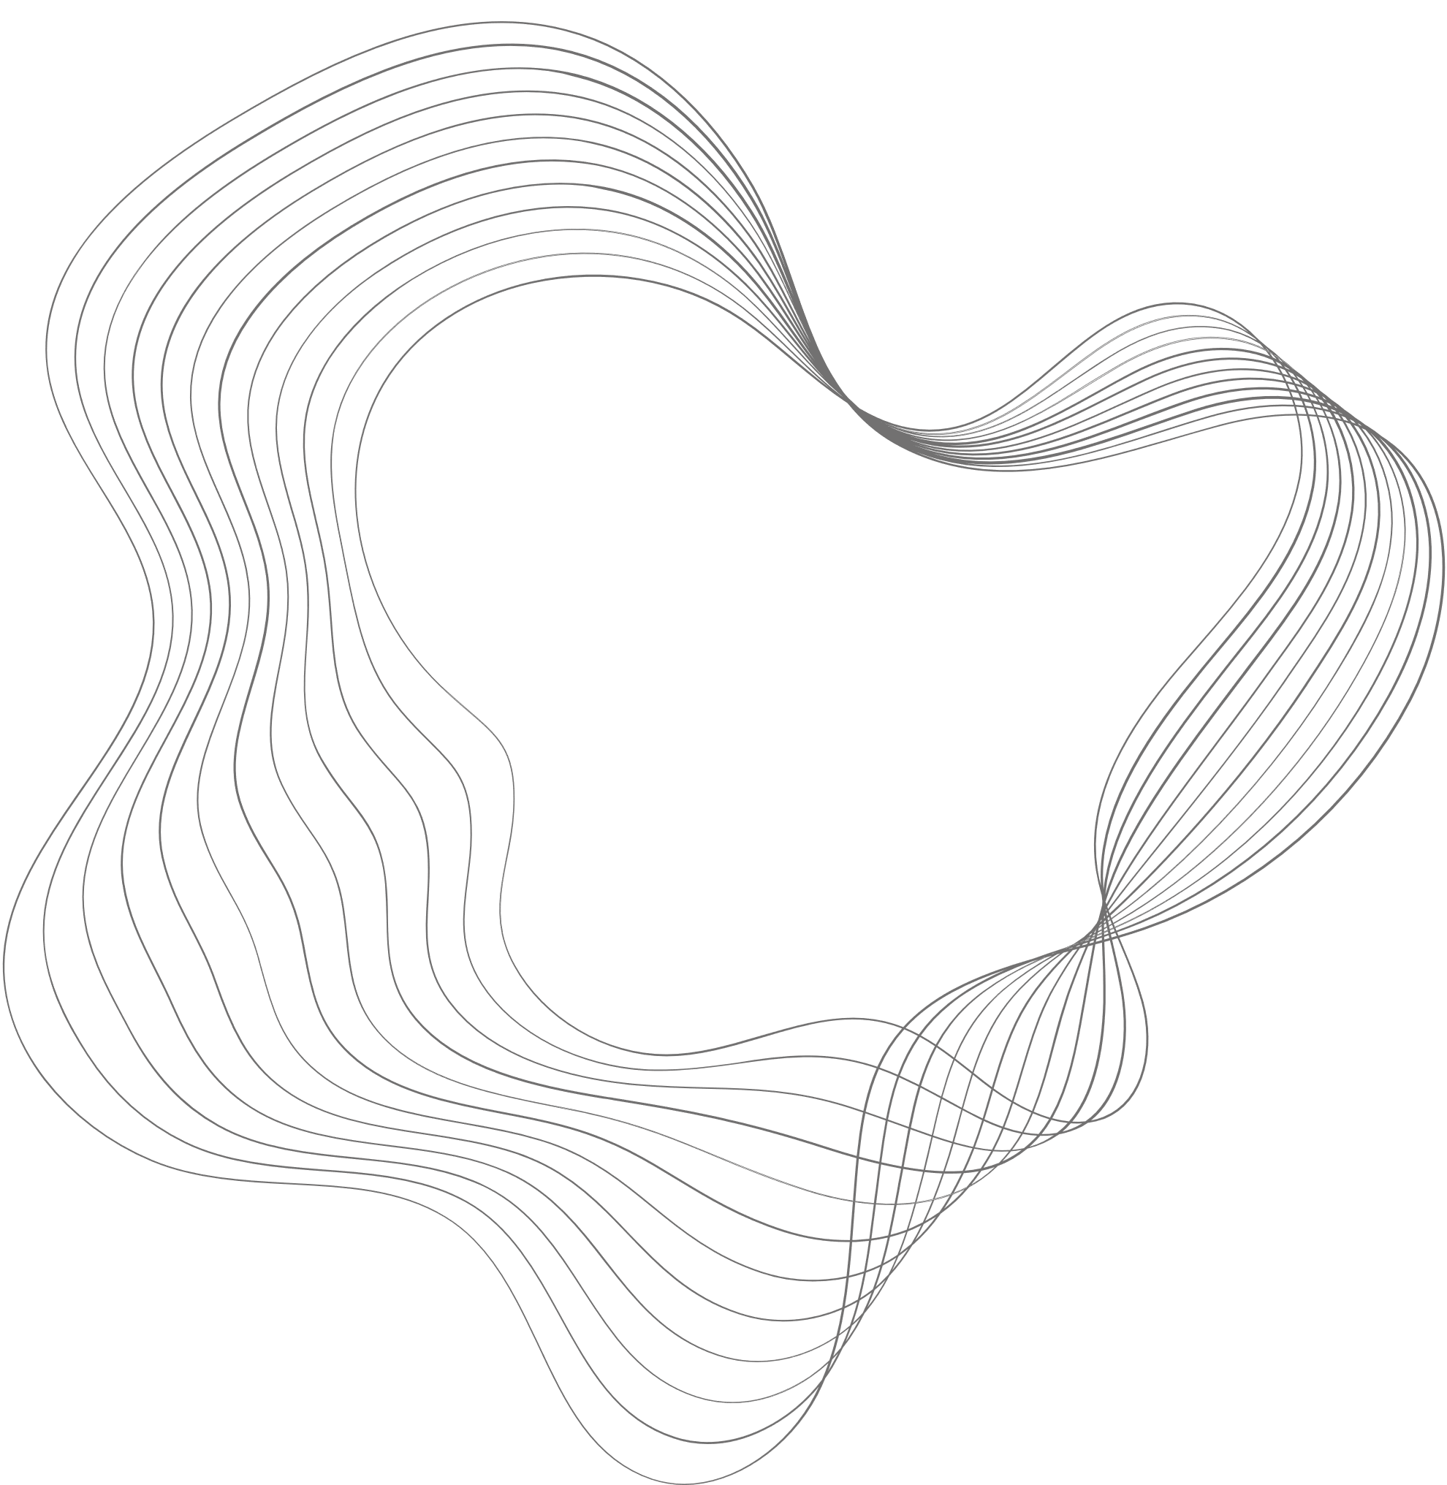
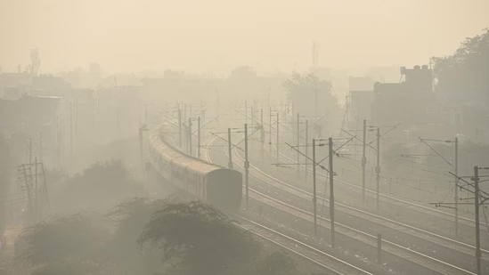
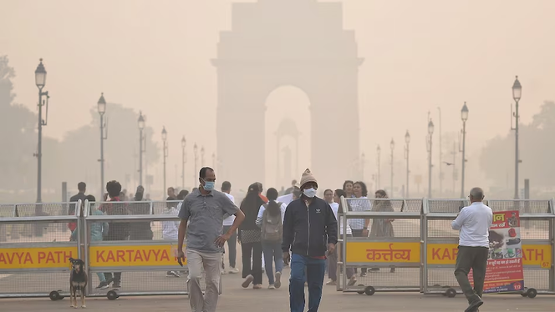
PROBLEM DEFINITION
The goal is to develop a City Pollution Monitoring and Alert System (CPMAS) that effectively tracks, analyzes, and forecasts air pollution levels in real time and citizens take proactive measures to combat pollution and minimize health risks.
Relevance Example Delhi
Delhi, one of the world’s most polluted cities, faces significant challenges related to air quality management due to factors like vehicular emissions, construction dust, stubble burning, and seasonal changes

Slide 5
PROBLEM IDENTIFIED
Lack of Real-Time Data:
Many cities lack a real-time pollution monitoring system, making it difficult to track and respond to sudden spikes in air pollution levels.
Inefficient Threshold Detection:
Without automated systems, authorities struggle to identify when pollution exceeds safe limits, delaying necessary interventions or alerts to residents.
Limited Geographic Coverage:
Existing pollution monitoring systems are often concentrated in specific areas, leaving significant portions of the city unmonitored, especially in underserved or densely populated zones.
Ineffective Resource Allocation:
Authorities face challenges in allocating resources, such as air purifiers, masks, or emergency medical aid, to the most affected areas due to a lack of actionable data.
Health Risks Due to Delayed Alerts:
Delayed or inadequate alert mechanisms fail to warn vulnerable populations, such as children, the elderly, and those with pre-existing conditions, leading to severe health consequences.

Slide 6


MODULES
01
02
03
04
1.Data Collection and Integration
Collect real-time pollution data from sensors, traffic data, and meteorological inputs.
2.Data Processing and Analysis
Apply clustering algorithms (e.g., K-Means) to identify pollution hotspots.
3: Visualization and User Interface
Create a dashboard displaying real-time pollution levels, alerts, and recommendations for mitigation.
4: Alert System and Notifications
Implement an alert system to notify users about high pollution levels, health risks, and suggested actions.

Slide 7


DATA STRUCTURES
Core Data Structures
Handle alert notifications or user interaction logs.
Store pollution readings for sensors in a time-series format.
Dynamically store historical pollution data for zones
3. STACKS AND QUEUES
1. ARRAY
2. LINKED LIST:

Slide 8
Represent the city as zones (nodes) and roads/interactions (edges) for pollution spread analysis.
Efficiently map sensor IDs to their respective data or city zones.
Store and manage city zones in hierarchical structures for efficient searching.
6. GRAPHS:
4. HASH TABLES
5. BINARY TREES (AVL, RED-BLACK):
Prioritize zones by pollution levels or severity of alerts.
Quickly calculate cumulative pollution data in a region.
7. HEAP (MIN-HEAP OR MAX-HEAP)
8. FENWICK TREE (BINARY INDEXED TREE):

Slide 9


ALGORITHMS
1. Brute Force:
Bubble Sort and Selection Sort: For ranking zones based on pollution levels.
Linear Search: To query specific pollution data by ID or zone.
String Processing: Handle pollution data or alert messages.
2. Divide and Conquer:
Binary Search: Quickly identify if pollution exceeds threshold levels.
Merge Sort and Quick Sort: Sort zones by pollution levels or other metrics.
3. Decrease and Conquer:
Insertion Sort: Maintain sorted lists of pollution records or alerts.
4. Graph Traversal:
Breadth-First Search (BFS): Analyze pollution spread across zones.
Depth-First Search (DFS): Find connected zones or paths with specific pollution levels.
Additional Algorithms to Include
5. Dijkstra’s Algorithm:
Find shortest paths for resource allocation (e.g., air purifiers) in the city.
6. Kruskal’s/Prim’s Algorithm:
Build a minimum spanning tree for efficiently connecting zones with pollution control systems
7. Clustering (e.g., K-Means):
Group zones with similar pollution levels for targeted action.
8. Sliding Window Algorithm:
Calculate moving averages of pollution over time for real-time monitoring.
9. Threshold Detection:
Trigger alerts when pollution crosses predefined thresholds (linear or binary search).
10. Dynamic Programming (DP):
Allocate resources optimally to minimize overall pollution impact

Slide 10


THANK'S FOR WATCHING
LARANA, INC.

